Slide 1
Paper ID: IEEM23-F-0522
Single Depot Heterogeneous Capacitated Vehicle Routing Problem with Simultaneous Delivery and Pickup for Disaster Management Systems
Santanu Banerjee¹ , Soumen Atta² , Goutam Sen¹ 1 Department of Industrial and Systems Engineering, Indian Institute of Technology (IIT) Kharagpur, Kharagpur 721302, West Bengal, India 2 Center for Information Technologies and Applied Mathematics, University of Nova Gorica, Vipavska 13, SI-5000 Nova Gorica, Slovenia
(santanu@kgpian.iitkgp.ac.in, soumen.atta@ung.si, gsen@iem.iitkgp.ac.in)
IEEM 2023 Conference Paper

Slide 2

Paper ID: IEEM23-F-0522
Single Depot Heterogeneous Capacitated Vehicle Routing Problem with Simultaneous Delivery and Pickup for Disaster Management Systems
IEEM 2023 Conference Presentation
By
Santanu Banerjee
MS Student in Operations Research
Department of Industrial and Systems Engineering (ISE)
Indian Institute of Technology (IIT), Kharagpur
Kharagpur- 721302, India

Slide 3
Topics :
Introduction
Necessity
Objectives
Mathematical Formulation
Solution Methodologies:
MachineTuning for parameter perturbation
JellyFishing search component for perturbing the ranges of MT perturbation parameters
Datasets

Slide 4
Introduction
Nature of losses w.r.t. natural disasters in India
Source : World Bank's India Disaster Management Program
 | Avg. Annual Economic² loss ↑ | Human loss ↓
Floods | 63% | 32%
Cyclones | 19% | 32%
Landslides | - | 2%
Earthquakes | 10% | 33%
Droughts | 5% | 1%
The present decade is seeing increased frequency of climate related emergencies and powerful disasters
From 1995 to 2020, India experienced 1,058 floods, cyclones, droughts, cold waves and heatwaves. Floods accounted for 33% of these disasters, followed by heatwaves (24%), droughts (22%), cold waves (16%) and cyclones (5%), according to the report¹.
Although prediction and prevention of disasters needs to be the highest priority, these need multiple technological breakthroughs.
We focus on the necessity for logistic planning in swift decision making during predictable disasters
The Global Assessment Report (GAR2022), released by the UN Office for Disaster Risk Reduction (UNDRR) estimates the number of disaster events to reach 560 a year or 1.5 each day by 2030, India being the most affected
A report by World Meteorological Organization (WMO) in 2021 suggests India lost $87 billion in 2020 due to natural calamities

Slide 5
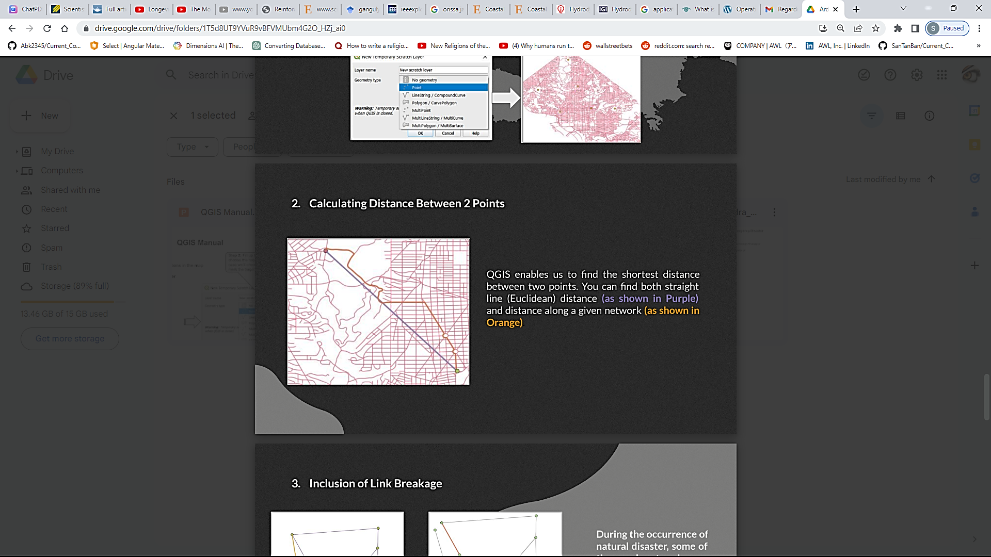
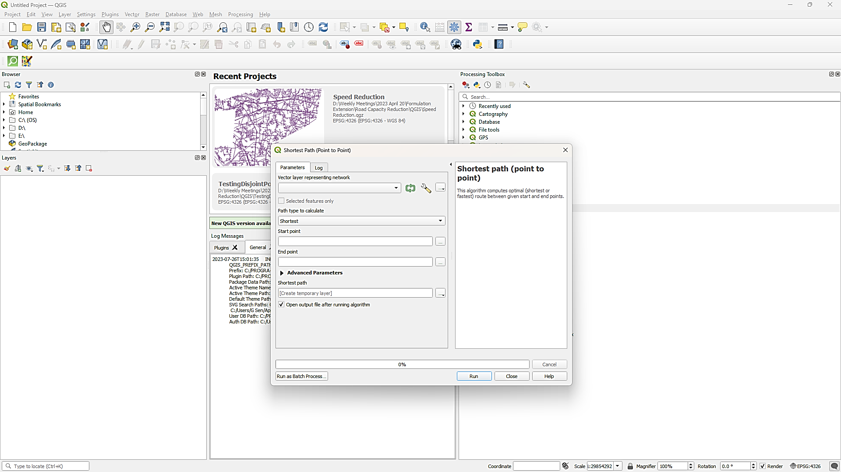
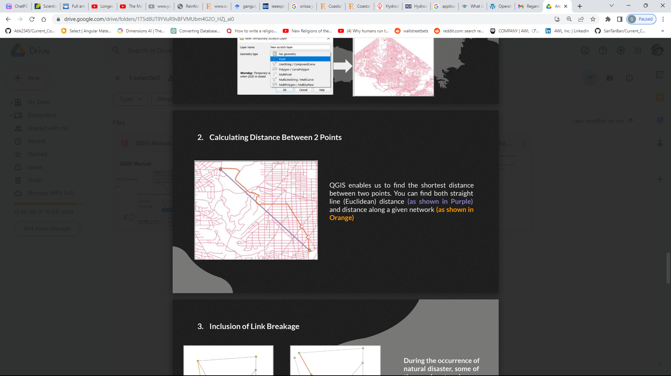
Necessity
National Remote Sensing Centre (NRSC) provides historical disaster data and predicted events information through the below portals:
Bhuvan: Disaster Management Support Services
National Database for Emergency Management (NDEM)
which lack extensive decision making support.
Limited existing routing tools in the open domains include:
Network Analysis tools like finding Shortest Paths
in-disaster multi-visit multi-trip routing and scheduling is not available currently,
Development of a generic tool for Vehicle Route Planning for Disasters/Emergency is therefore necessary and urgently required for incorporation within the existing Emergency Operation Plans (EOP).

Slide 6
Objectives
Modelling and optimizing a Single Depot Heterogeneous Capacitated Vehicle Routing Problem (VRP) with Simultaneous Delivery & Pickup for Emergency/Disaster Management.
The features of this formulation includes:
Routing a limited Heterogeneous Fleet of Vehicles from a Single Depot (single-trip per vehicle)
Ensuring Vehicle Type compatibility with Road Networks
Performing delivery and pickup operation simultaneously (single-visit per node)
Vehicle capacity-constrained routings Objective: Minimize the sum of fixed and variable costs of the vehicular routes (which can be easily altered to minimize the total travelling distance) as the Objective function
Dataset: Develop a novel dataset for future benchmarking of the differing distances between the same nodes for different vehicle types, representing the effect of the vehicle-road compatibility.
}
Problem
Description

Slide 7
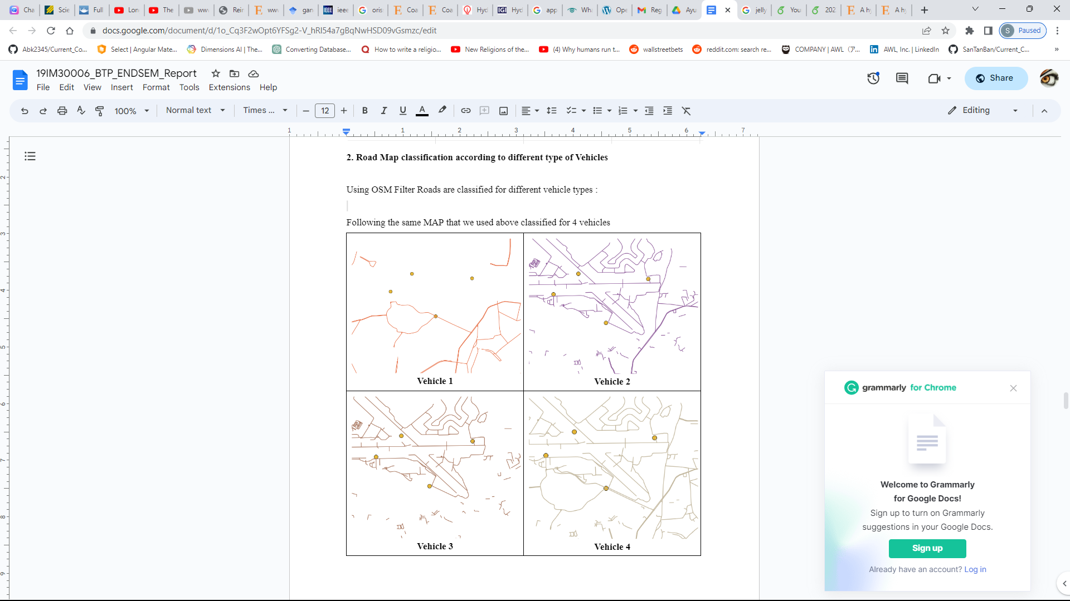
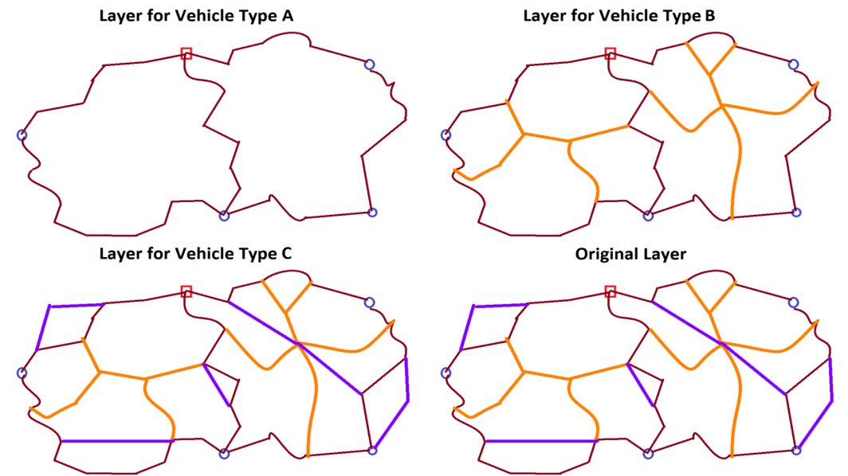
We include the feature of Vehicle Type compatibility with Road by allowing splitting the original network layer to generate multiple network layers compatible with each vehicle type
The present problem lies in Compatibility of Roads and Vehicles: Large vehicles with big width will not be able to ply on village roads where only small vehicles will have access.
Each Layer Network may be generated by comparing road width or/and other available attributes (like type of highway from OpenStreetMaps)

Slide 8
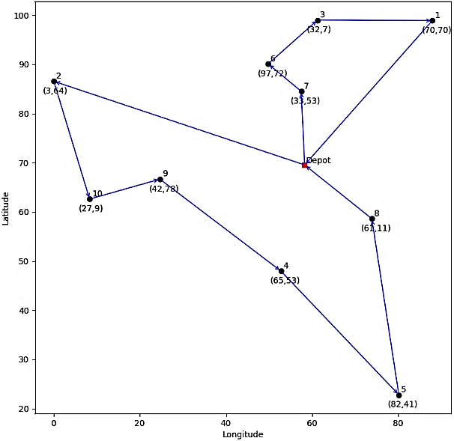
Detailed Problem Description
We develop a Mixed Integer Linear Programming formulation considering a vehicle routing problem with:
A single depot
containing a heterogeneous fleet of vehicles
Multiple nodes with pickup and delivery demands
A static distance network (varying with vehicle type)
Single-trip per vehicle performing simultaneous delivery and pickup
Assumption: largest vehicle capacity must be greater than the largest individual demand

Slide 9
Existing HF VRP SDP Formulations
Travelling Salesman Problem (TSP)
Vehicle Routing Problem (VRP)
We refer to two papers for our problem of HFVRPSDP:
Avci, Topaloglu 2016 [13]
Keçeci et.al. 2021 [14]
for comparing their exact formulations to develop an improved compact version for swifter solutions
Heterogeneous Fleet Vehicle Routing Problem (HF VRP, H VRP)
Vehicle Routing Problem with Simultaneous Delivery and Pickup (VRP SDP , VRP SPD, VRP SDC)
Heterogeneous Fleet Vehicle Routing Problem with Simultaneous Delivery and Pickup (HF VRP SDP)

Slide 10
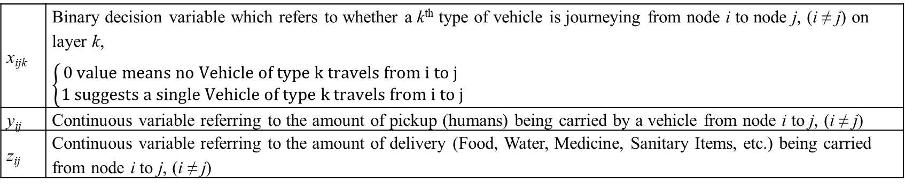
Notations used
N | Set of all Nodes/Relief Points, where |N| = n
N₀ | Set of all Relief Points and the Depot, where |N₀| = n+1 (Depot being the 0th Node)
p_{i} | Denotes the pickup quantity associated with Node i
d_{i} | Denotes the delivery quantity associated with Node i
C | Distance matrix consisting of network specific distances between two Nodes w.r.t. Vehicle Types. Each element may be referenced by C_{ijk} which is the shortest distance required to travel from node i to node j, (i ≠ j) for vehicles of type k. The vehicle type specific network layers are generated for each vehicle type according to road compatibility.
T | Set of all Vehicle Types, generally the k subscript is used to refer to this
Q_{k} | Denotes the capacity of a vehicle of type k
H_{k} | Denotes the number of vehicles available of its respective vehicle type k
F_{k} | Denotes the fixed cost related to dispatching a vehicle of type k
V_{k} | Denotes the variable cost per unit length of route related to dispatching a vehicle of type
Sets & Parameters
x_{ijk} | Binary decision variable which refers to whether a k^{th} type of vehicle is journeying from node i to node j, (i ≠ j) on layer k, $\left\{\begin{aligned}0 value means no Vehicle of type k travels from i to j \\ 1 suggests a single Vehicle of type k travels from i to j\end{aligned}\right.$
y_{ij} | Continuous variable referring to the amount of pickup (humans) being carried by a vehicle from node i to j, (i ≠ j)
z_{ij} | Continuous variable referring to the amount of delivery (Food, Water, Medicine, Sanitary Items, etc.) being carried from node i to j, (i ≠ j)
Decision Variables

Slide 11
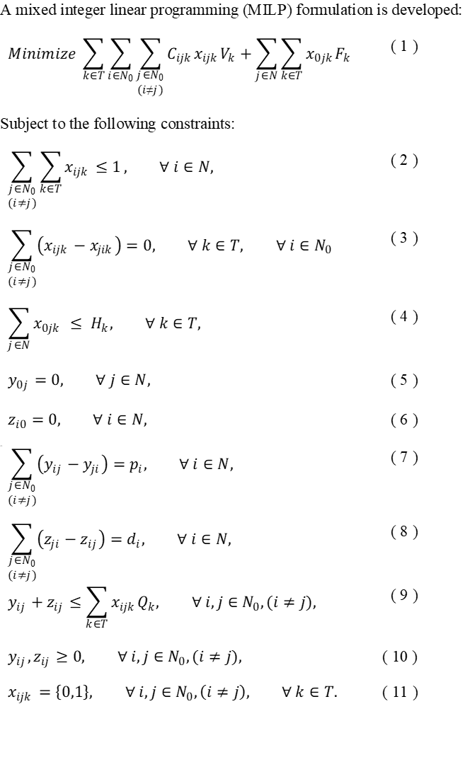
MILP Formulation

Slide 12
Changes made w.r.t Avci Topaloglu 2016 are shown:
Subscript k in the distance calculation instead of C_{ij}
Reducing the flow variables by removing an un-necessary subscript k from their y_{ijk}, z_{ijk} variables

Slide 13
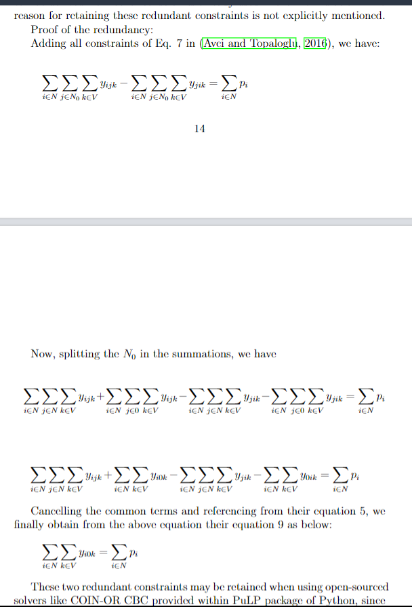
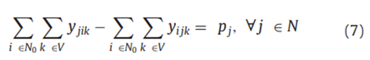
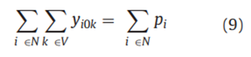
We further identify redundant constraints used in Avci Topaloglu (2016) and remove them
Mathematical Proof of redundancy:
Avci Topaloglu 2016 used the following equations within their formulation:
We identify our problem formulation to be more compact than the best formulation available due to simpler flow constraints

Slide 14
Explanations of the constraints used
Eq. (2) constrains that each node may be visited by at most one single vehicle
Eq. (3) equalizes the sum of incoming and outgoing paths for all vertices individually
Eq. (4) limits the outgoing vehicles for each type from the depot as per the initially provided availability
Equations (5) and (6) ensure that no extra delivery quantity is dispatched by eliminating any return of the delivery loads back to the depot, and similarly for the pickup quantity ensuring no pickup is carried from the depot
Eq. (7) balances the sum of incoming and outgoing pickup flow values for each node as per its demand; and similarly for Eq. (8)
Eq. (9) ensures that the capacity constraints for each individual vehicle is never violated.

Slide 15
Computational Results Set 1 (upon exact data obtained from authors Avci Topaloglu 2016)
Computational Results Set 2 (upon exact data obtained from authors Avci Topaloglu 2016)
Set 1 Instances | No. of Nodes | Upto No. of Vehicle Types Used | Number of Vehicles available for each Type |  | Exact Formulations
 |  |  |  |  | Keçeci et al. (2021) |  |  |  | Our Developed Exact Formulation
 |  |  |  |  | Gurobi | Solution Time | MIP Gap |  | Gurobi Objective Value | Solution Time | MIP Gap
 |  |  |  |  | Objective Value | (seconds) |  |  |  | (seconds)
1 | 10 | 2 | 10 |  | 620.2 | 2.1 | 0 |  | 620.2 | 1 | 0
2 | 10 | 2 | 10 |  | 588.5 | 1.1 | 0 |  | 588.5 | 0.7 | 0
3 | 15 | 3 | 15 |  | 445.1 | 79.3 | 0 |  | 445.1 | 18.4 | 0
4 | 15 | 4 | 15 |  | 437.1 | 608.1 | 0 |  | 437.1 | 439.2 | 0
5 | 20 | 3 | 20 |  | 494 | 5764.5 | 0 |  | 494 | 2819.5 | 0
6 | 20 | 4 | 20 |  | 542.7 | 5190.5 | 0 |  | 542.7 | 2046.9 | 0
7 | 35 | 3 | 35 |  | 1115.5 | 86400 | 0.1 |  | 1099.3 | 86400 | 0.1
8 | 35 | 3 | 35 |  | 1662.5 | 86400 | 0.1 |  | 1672.4 | 86400 | 0.1
9 | 50 | 3 | 50 |  | 991.8 | 86400 | 0.1 |  | 946 | 86400 | 0.1
10 | 50 | 2 | 50 |  | 1209.7 | 86400 | 0.1 |  | 1167.2 | 86400 | 0.1
11 | 75 | 3 | 75 |  | 1613.6 | 86400 | 0.1 |  | 1613.7 | 86400 | 0.1
12 | 75 | 2 | 75 |  | 917.4 | 86400 | 0 |  | 1001.4 | 86400 | 0.1
13 | 100 | 2 | 100 |  | 1319.7 | 86400 | 0.1 |  | 1296.2 | 86400 | 0.1
14 | 100 | 2 | 100 |  | 1616.1 | 86400 | 0.2 |  | 1514.4 | 86400 | 0.1
Set 2 Instances | No. of Nodes | Upto No. of Vehicle Types Used | Number of Vehicles available for each Type |  | Exact Formulations
 |  |  |  |  | Keçeci et al. (2021) |  |  |  | Our Developed Exact Formulation
 |  |  |  |  | Gurobi | Solution Time | MIP Gap % |  | Gurobi Objective Value | Solution Time | MIP Gap %
 |  |  |  |  | Objective Value | (seconds) |  |  |  | (seconds)
1 | 150 | 3 | 150 |  | 1470.87 | 86400 | 12.82% |  | 1481.57 | 86400 | 13.84%
2 | 150 | 3 | 150 |  | 2246.47 | 86400 | 16.58% |  | 2238.87 | 86400 | 16.67%
3 | 200 | 3 | 200 |  | 3421.54 | 86400 | 18.38% |  | 3385.19 | 86400 | 18.08%
4 | 200 | 2 | 200 |  | 2216.52 | 86400 | 16.16% |  | 2205.17 | 86400 | 16.45%
5 | 250 | 3 | 250 |  | 2514.62 | 86400 | 17.45% |  | 2465.87 | 86400 | 16.55%
6 | 250 | 2 | 250 |  | 2345.34 | 86400 | 15.40% |  | 2165.98 | 86400 | 8.58%
7 | 300 | 3 | 300 |  | 3129.59 | 86400 | 34.97% |  | 2708.34 | 86400 | 25.14%
8 | 300 | 2 | 300 |  | 3021.09 | 86400 | 32.85% |  | 2659.28 | 86400 | 24.08%
9 | 350 | 3 | 350 |  | 4868.38 | 86400 | 44.49% |  | 4305.98 | 86400 | 37.64%
10 | 350 | 2 | 350 |  | 4170.55 | 86400 | 54.93% |  | 2339.28 | 86400 | 20.00%
11 | 400 | 2 | 400 |  | 5105.27 | 86400 | 45.80% |  | 4448.78 | 86400 | 37.98%
12 | 400 | 2 | 400 |  | 5158.87 | 86400 | 51.44% |  | 4795.2 | 86400 | 48.27%
13 | 500 | 2 | 500 |  | 9896 | 86400 | 35.11% |  | 9679.11 | 86400 | 33.25%
14 | 550 | 2 | 550 |  | 13894.53 | 86400 | 42.93% |  | 12657.35 | 86400 | 37.68%

Slide 16
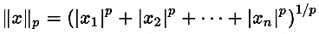
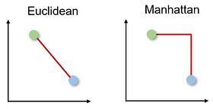
Dataset Creation for future benchmarking on the given problem by generating synthetic data:
Latitude, Longitude, PickUp and Delivery values are varied randomly between [0,125] (a standard practice and similar ranges are followed in Avci Topaloglu 2016)
Since we consider vehicle road compatibility, we need to further vary the distance matrix as per different vehicle types and therefore we consider varying the distance formula.
This p-value from the Minkowski Distance or L_{p}Norm is ranged between (1, 2) to obtain the desired effect.
For our Dataset, we used these p-values for the different vehicle types:
Vehicle Type | 1 | 2 | 3 | 4
p-value | 1.8 | 1.6 | 1.4 | 1.2
p=2 p=1

Slide 17
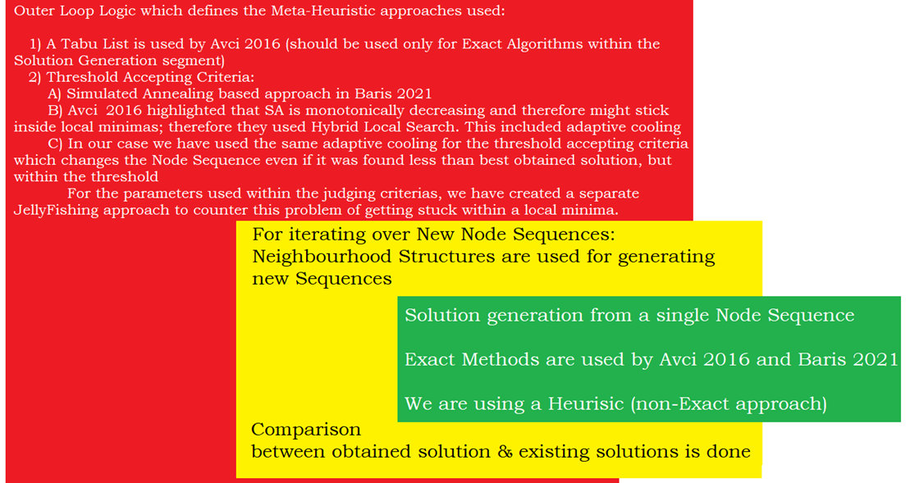
Developing Heuristic and its flavours
Local Search (LS) Technique and Threshold Accepting (TA) Criterias are used from Avci Topaloglu 2016’s ATS Heuristic
Outer Loop Logic:
Threshold Accepting Criteria
Adaptive cooling retained from Avci Topaloglu 2016 ATS Heuristic
Logic for Local Search:
Generation of new Node Sequences through iterations over all Neighbourhood Structures:
4 Neighbourhood Structures retained from Avci Topaloglu 2016’s ATS Heuristic
4 new Neighbourhood Structures developed
Inner Loop Logic:
Solution generation strategy from single Node Sequence
We use a new non-exact Decoding Mechanism.
Exact Methods are used by Avci Topaloglu (2016) and Keçeci et al. (2021)

Slide 18
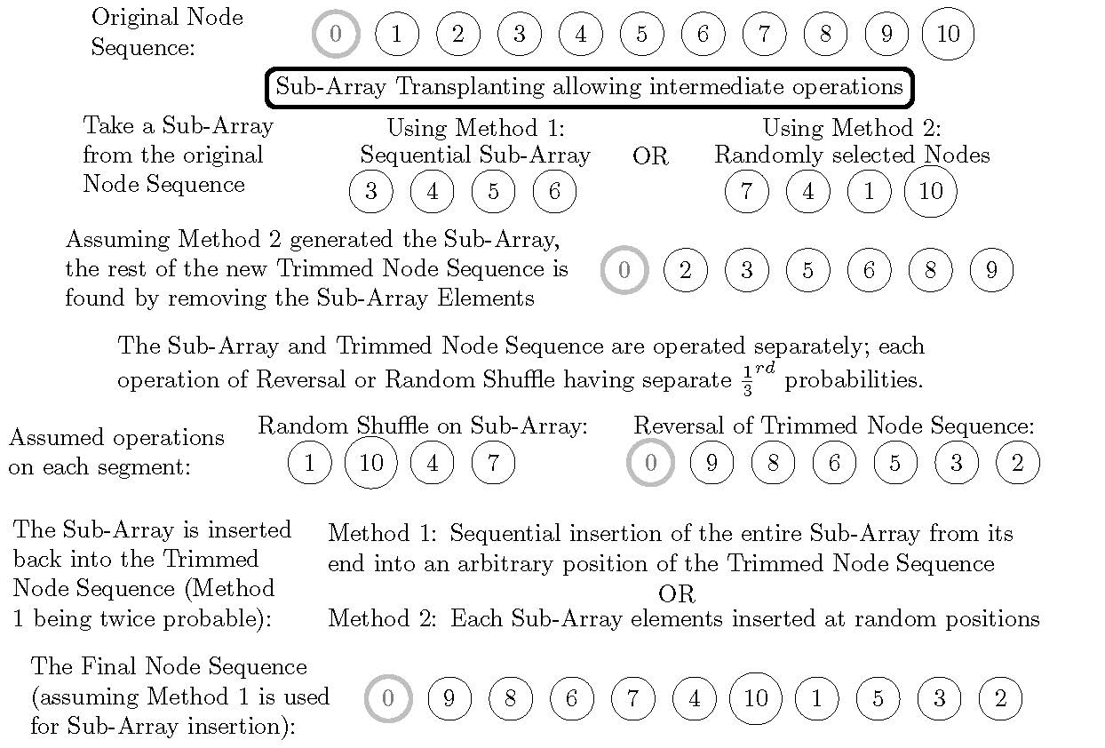
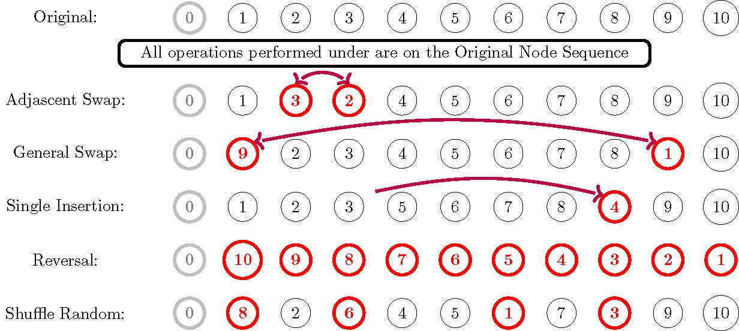
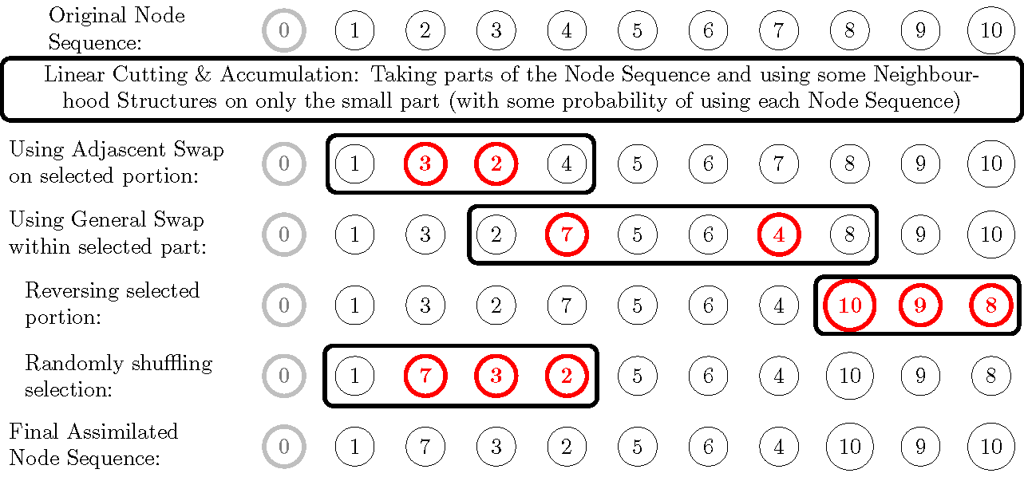
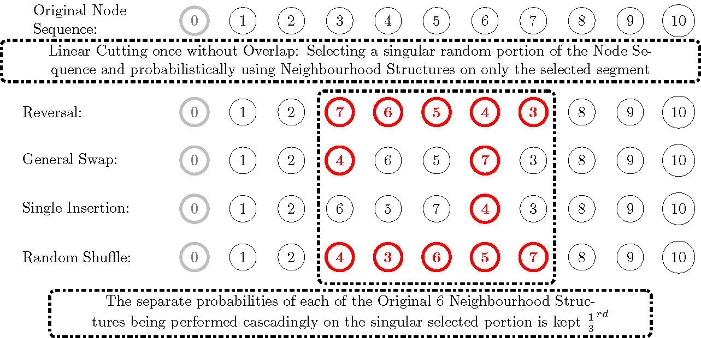
Neighbourhood Structures

Slide 19
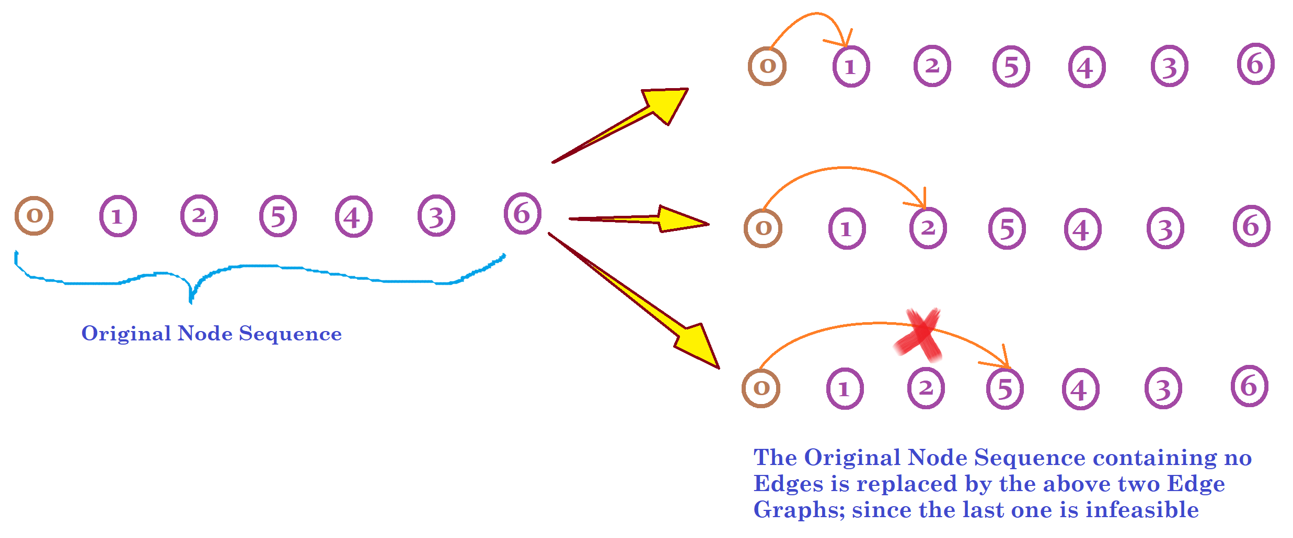
Decoding Mechanism:
For the considered Node Sequence, We start with the 0th Node

Slide 20
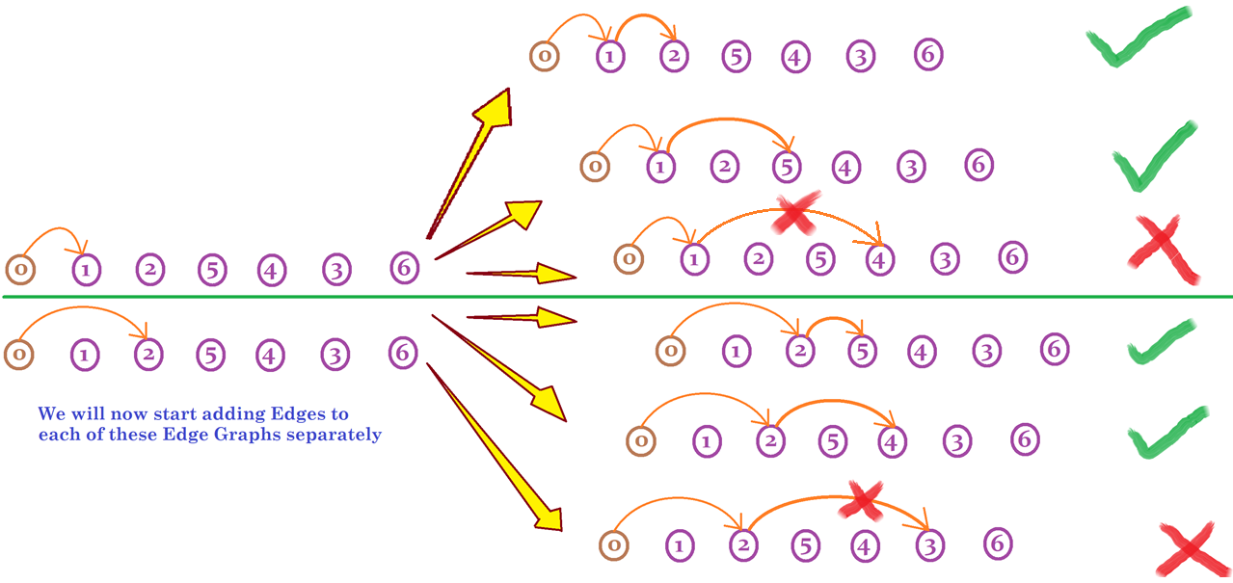
The new Edges are respectively added to its Mother Edge Graph.
In the next phase of analysis, the green ticked Edges are retained as the starting Mother Edge Graph for the subsequent Edge additions.

Slide 21
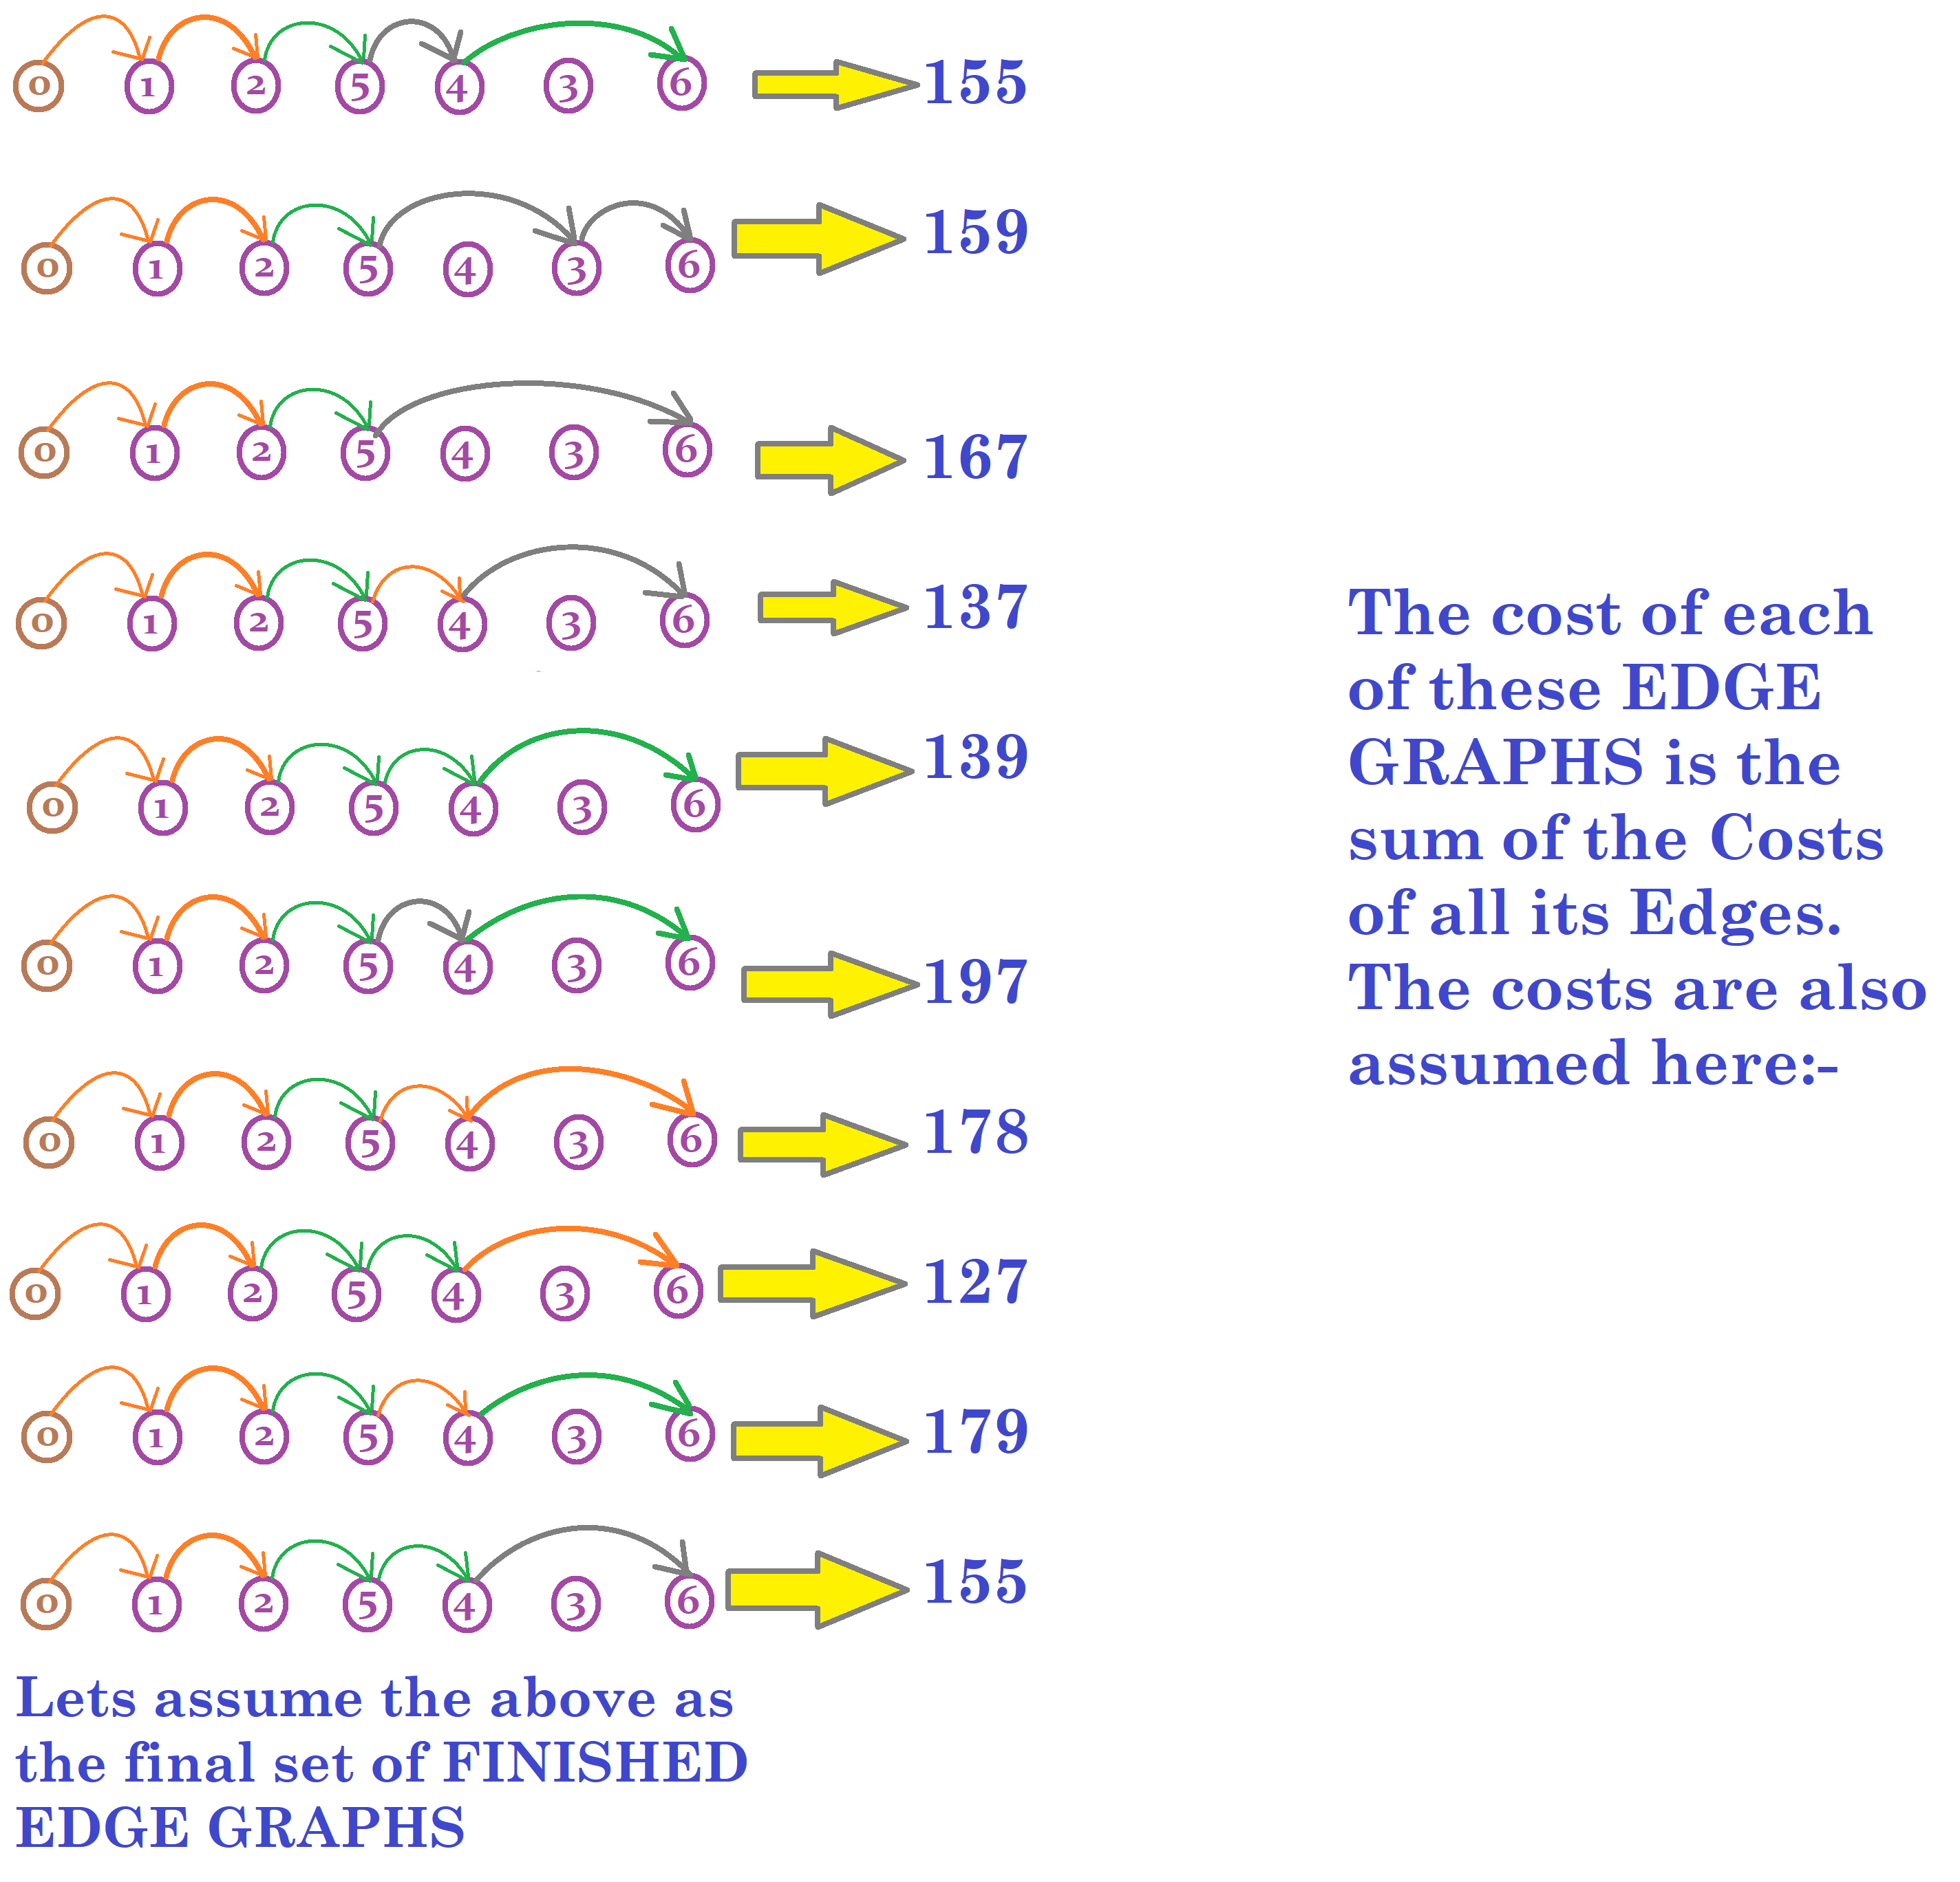
The Edge Graph Generation procedures will end when there are no Mother Edge Graphs
Subsequently, the Finished Edge Graph set is analysed to find the minimum cost Edge Graph which is then the solution of the Decoding Mechanism

Slide 22
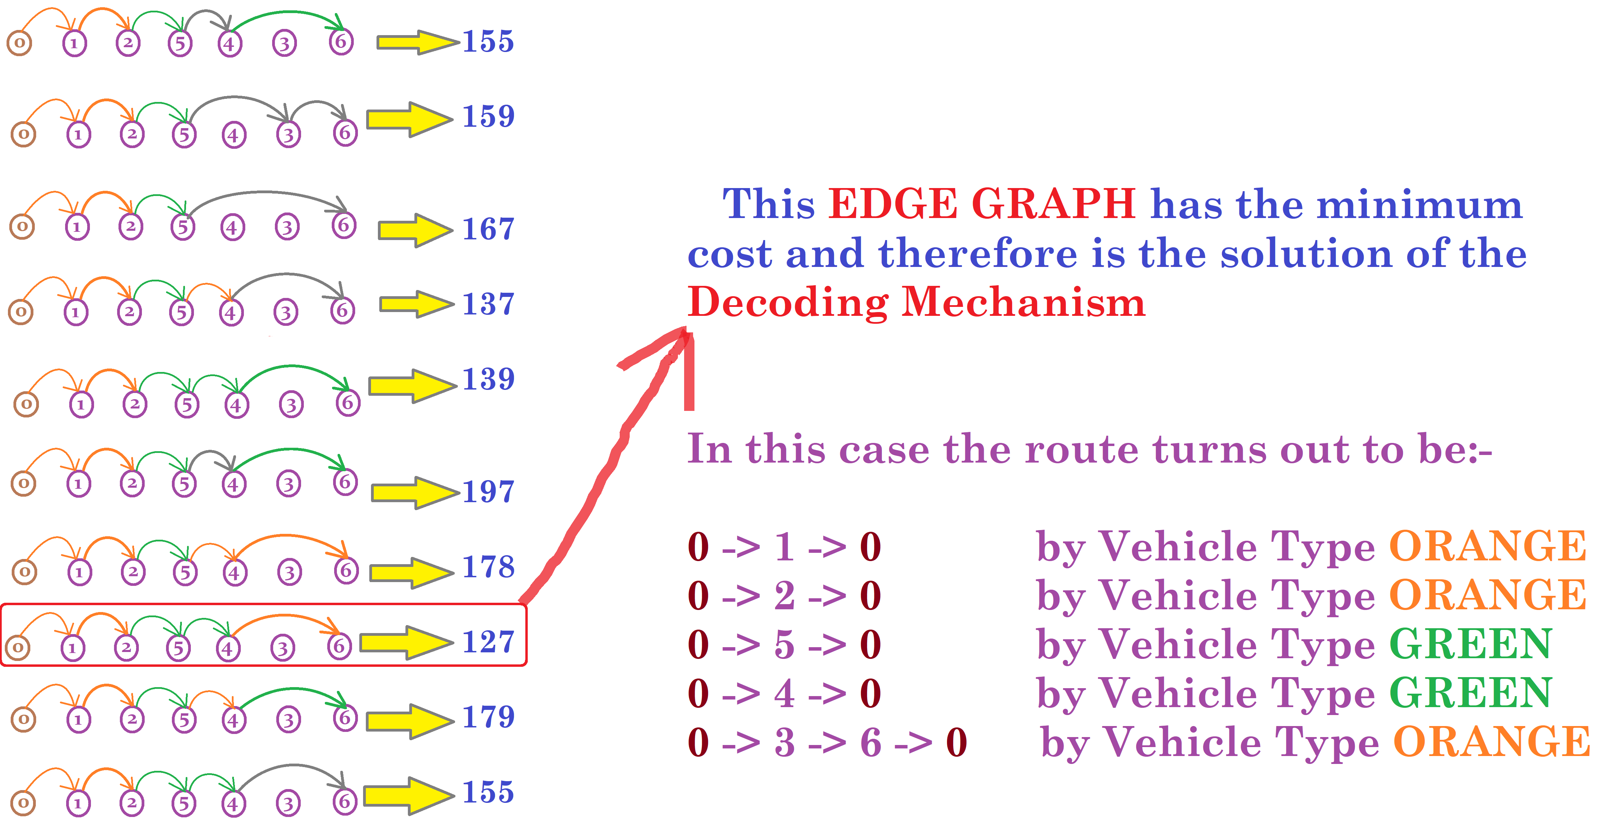

Slide 23
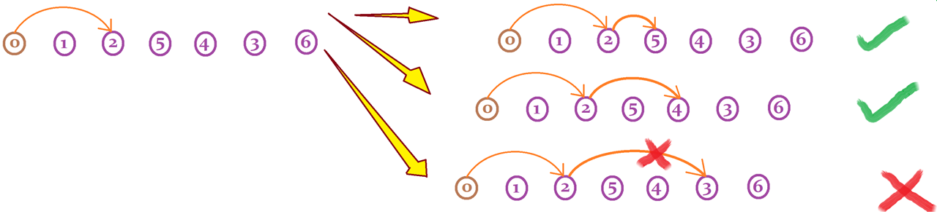
The Heuristic discussed till here (we name it as ATSAH) is capable of generating good solutions but for smaller instances of the problem
For larger instances, it starts to take a lot of time and often runs into memory issue.
We identify that the process of accepting all new Edges lead to an enormous number of combinations.
Earlier we were accepting all the feasible edges to create separate new Mother Graphs.
Now we devise a dynamic formula to accept only a single new Edge for the Mother Graph to proceed on towards the developing a single Traversed Graph.

Slide 24
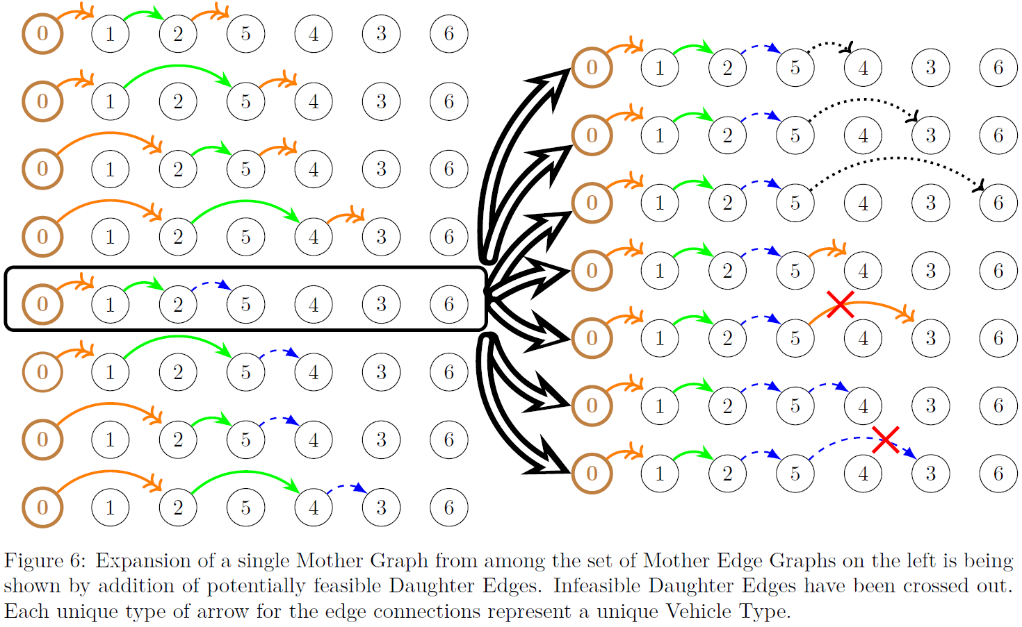
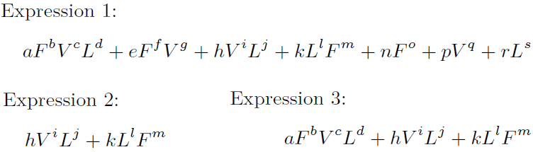
Present Heuristic progressively creates Edges and judges whether to keep them using Machine-Tuning
The parameters of new Edges (L,F,V) are fed into either of the 3 judging formulas
Assumed Node Sequence with few Edges:
Length of the route (number of nodes) (L)
Fixed Cost of the route (F)
Variable Cost of the route (V)
Multiple New Edges are created:-
The Edge (from among the newly created Edges) which has the minimum value of the above selected Expression is added to the solution
This process is continued till the last Node is reached (i.e. no Node is left).

Slide 25
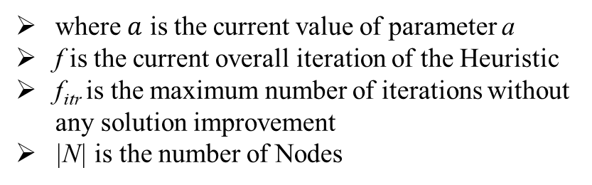
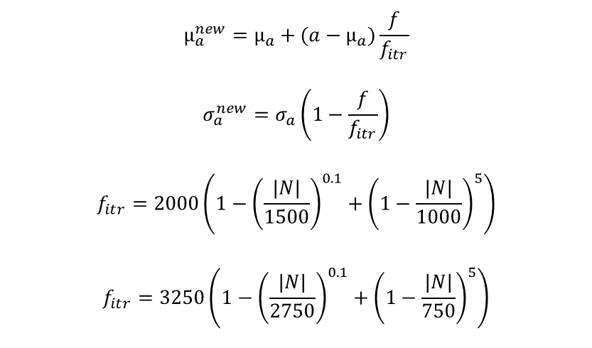
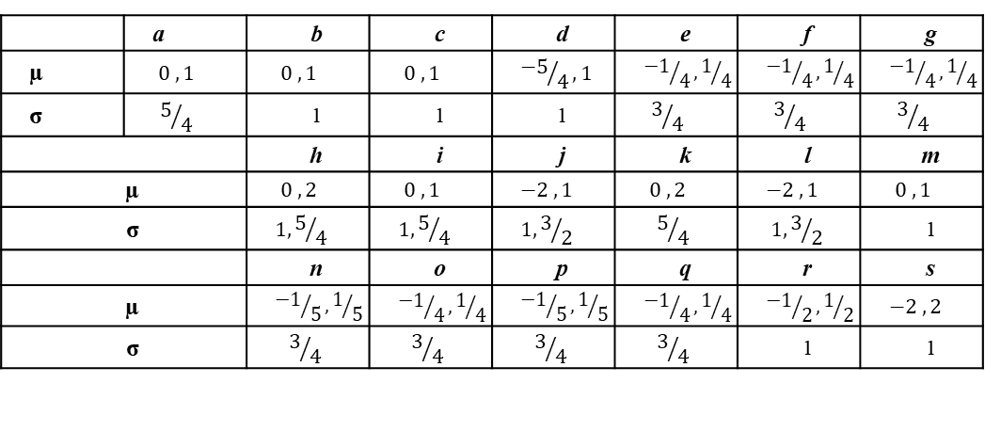
Parameter Perturbation:
For each parameter we have a Mean (μ) and a Standard Deviation (σ). The equations for changing the parameter value whenever better solutions are obtained is shown:
$$µ_{a}^{new}=µ_{a}+(a−µ_{a})\frac{f}{f_{itr}}$$
$$σ_{a}^{new}=σ_{a}\left(1−\frac{f}{f_{itr}}\right)$$
$$f_{itr}=2000\left(1−{\left(\frac{|N|}{1500}\right)}^{0.1}+{\left(1−\frac{|N|}{1000}\right)}^{5}\right)$$
$$f_{itr}=3250\left(1−{\left(\frac{|N|}{2750}\right)}^{0.1}+{\left(1−\frac{|N|}{750}\right)}^{5}\right)$$
where $a$ is the current value of parameter a
f is the current overall iteration of the Heuristic
f_{itr} is the maximum number of iterations without any solution improvement
|N| is the number of Nodes
The terminating criteria of the Heuristic algorithm is when f reaches f_{itr} (we use the later equation to calculate f_{itr} for larger problem sizes)
 | a | b | c | d | e | f | g
µ | $$0 , 1$$ | $$0 , 1$$ | $$0 , 1$$ | $${−5}/4,1$$ | $${−1}/4,1/4$$ | $${−1}/4,1/4$$ | $${−1}/4,1/4$$
σ | $$5/4$$ | 1 | 1 | 1 | $$3/4$$ | $$3/4$$ | $$3/4$$
 |  | h | i | j | k | l | m
µ |  | $$0 , 2$$ | $$0 , 1$$ | $$−2 , 1$$ | $$0 , 2$$ | $$−2 , 1$$ | $$0 , 1$$
σ |  | $$1,5/4$$ | $$1,5/4$$ | $$1,3/2$$ | $$5/4$$ | $$1,3/2$$ | 1
 |  | n | o | p | q | r | s
µ |  | $${−1}/5,1/5$$ | $${−1}/4,1/4$$ | $${−1}/5,1/5$$ | $${−1}/4,1/4$$ | $${−1}/2,1/2$$ | $$−2 , 2$$
σ |  | $$3/4$$ | $$3/4$$ | $$3/4$$ | $$3/4$$ | 1 | 1
Initial parameter values
The Algorithm till here is named ATSA-MT where MT stands for Machine Tuning

Slide 26
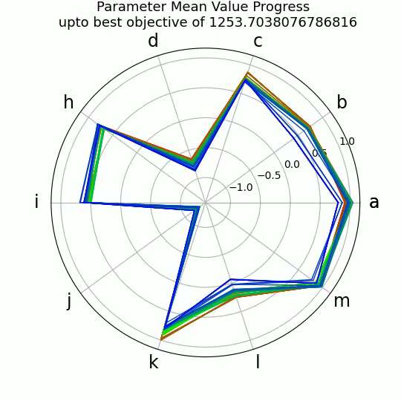
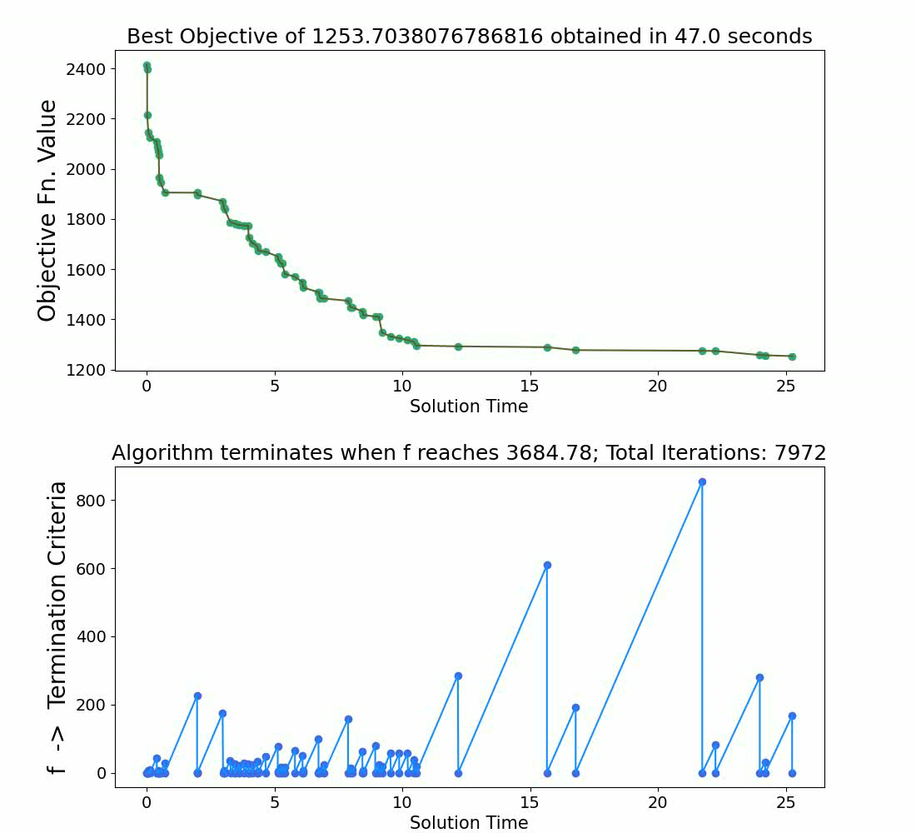
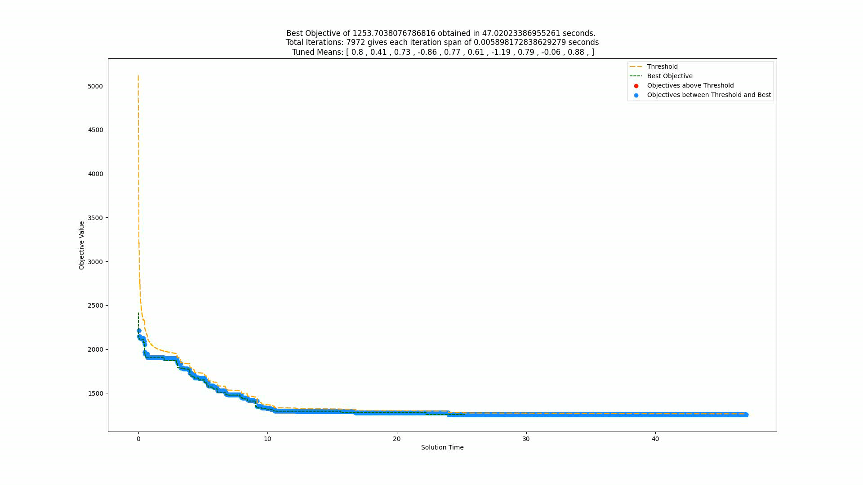
Solution comparison for the 35 Node instance is shown for the ATSA-MT-10 (for all the 30 runs):

Slide 27

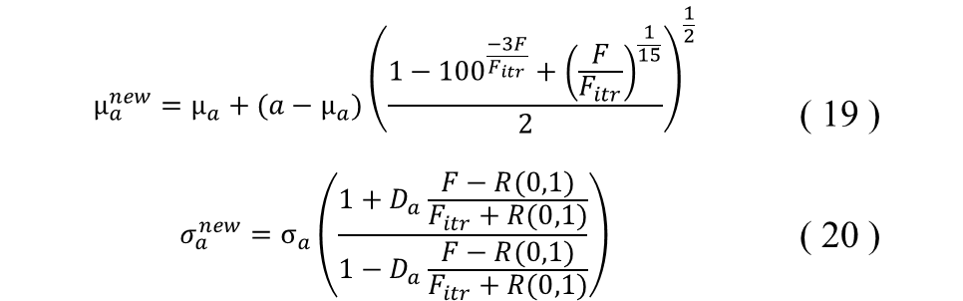
Introduction of the JellyFishing Search:
Problem Identified in the ATSA-MT:
S.D. values of all parameters become exceedingly low
We remove this bottleneck by introducing a new technique inspired by the locomotion of Jellyfishes
We imagine the Bell/Hood of a Jellyfish to be the S.D.
Whenever the S.D. for a parameter breaches a threshold minimum, the S.D. starts increasing (Relax Phase)
Similarly after breaching an upper-threshold, the S.D. starts decreasing again (Squeeze Phase)
This process of Squeeze and Relax continues until the Heuristic terminates…
We now use equations (19) and (20) to update µ and σ for each parameter:
where R(α,β) refers to a random number in the range [α, β]
and D is independent Search Directions for each parameter, taking value 1 when the corresponding parameter’s S.D. is less than 10⁻⁹, and -1 when the corresponding parameter’s S.D. is more than 10⁰
$$µ_{a}^{new}=µ_{a}+(a−µ_{a}){\left(\frac{1−{100}^{\frac{−3F}{F_{itr}}}+{\left(\frac{F}{F_{itr}}\right)}^{\frac{1}{15}}}{2}\right)}^{\frac{1}{2}}$$ | ( 19 )
$$σ_{a}^{new}=σ_{a}\left(\frac{1+D_{a}\frac{F−R(0,1)}{F_{itr}+R(0,1)}}{1−D_{a}\frac{F−R(0,1)}{F_{itr}+R(0,1)}}\right)$$ | ( 20 )

Slide 28
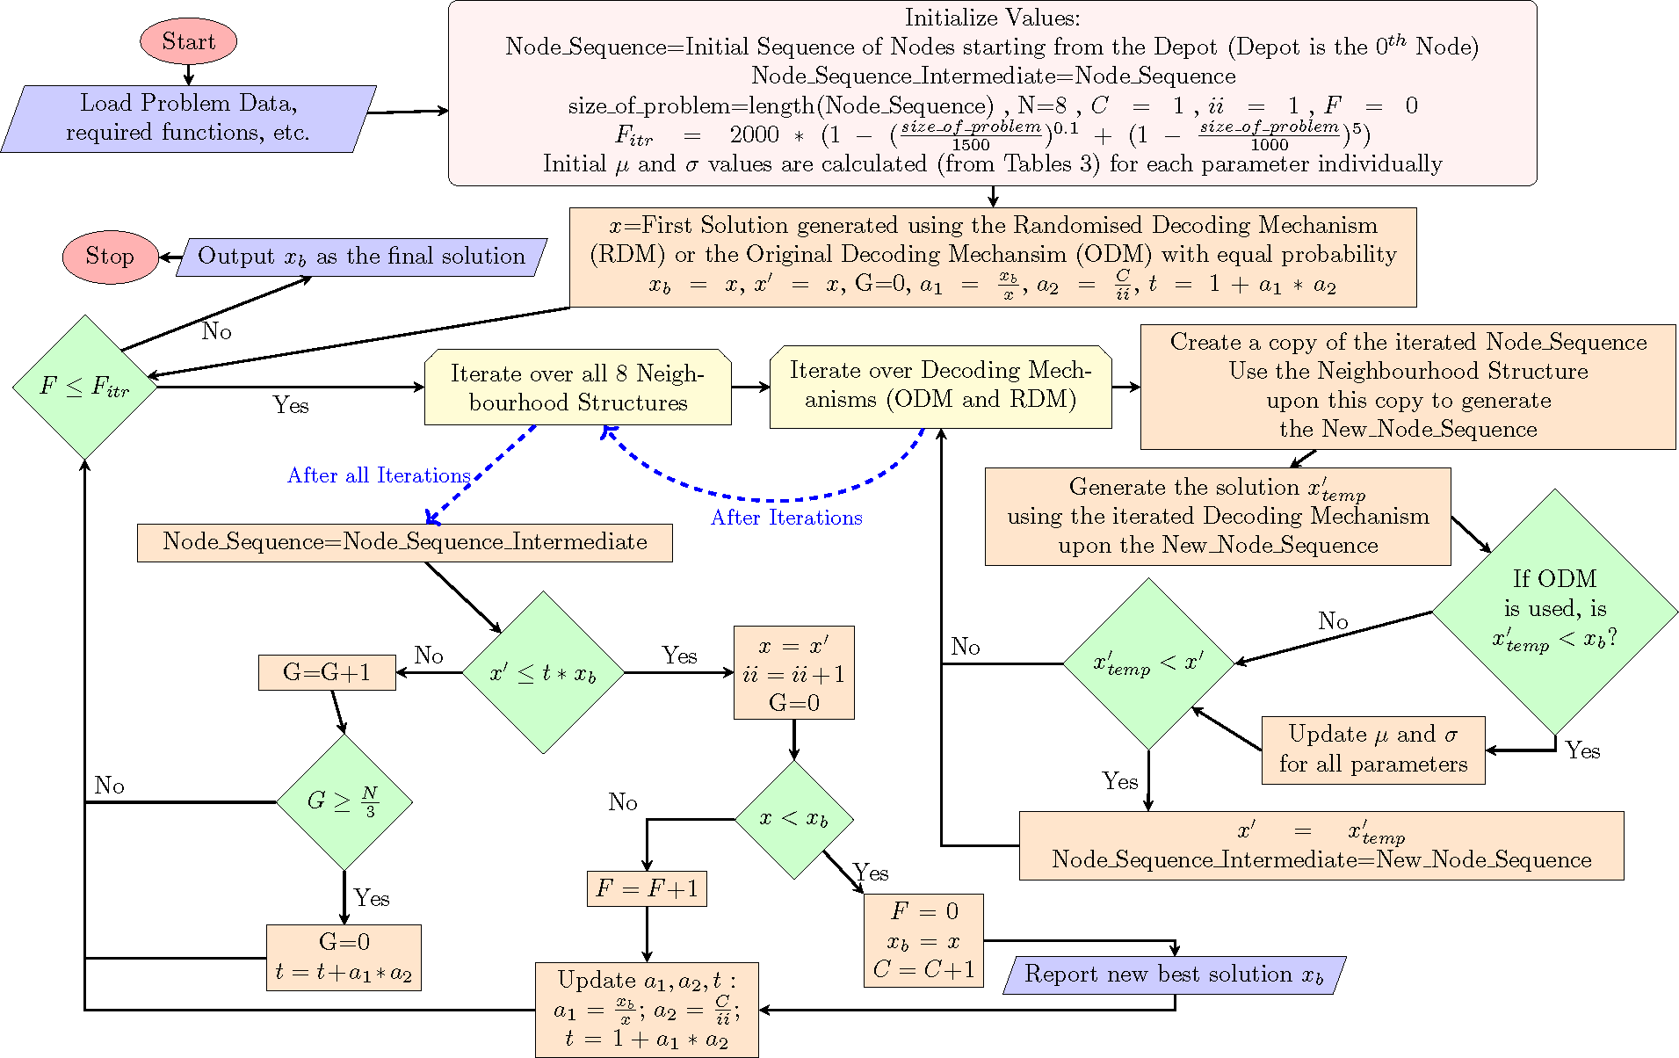

Slide 29
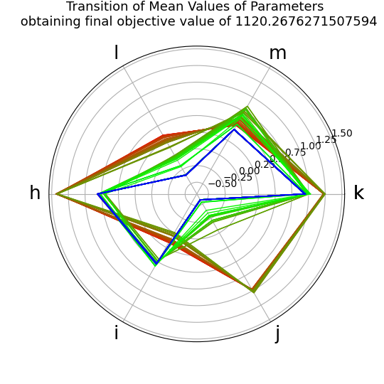
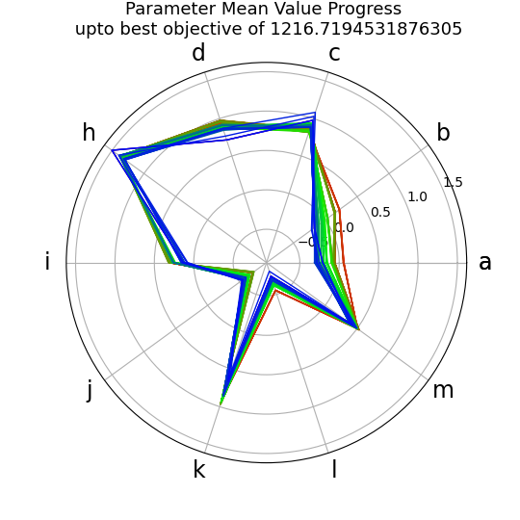
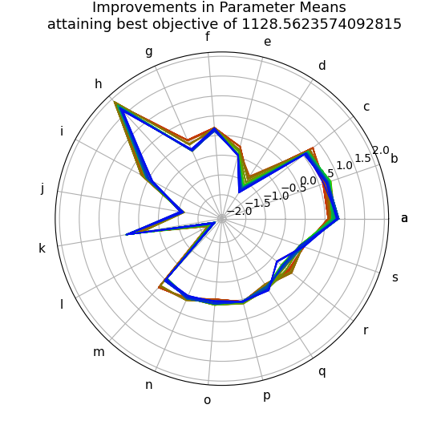
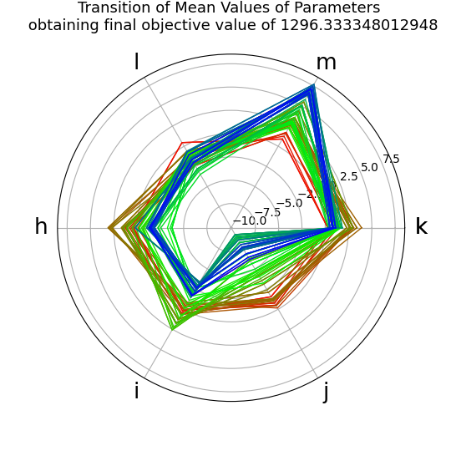
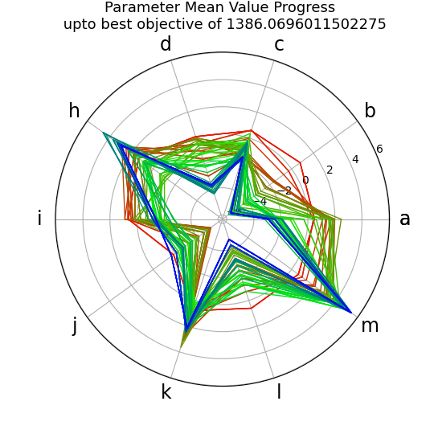
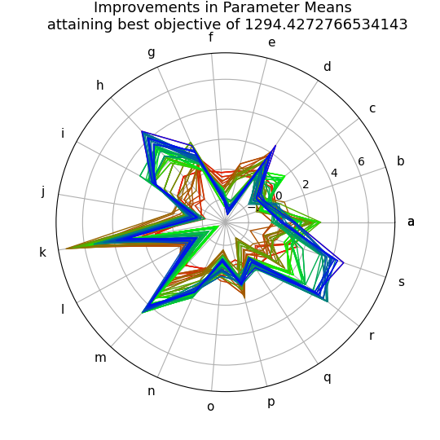
For one of the many runs with 35 Nodes | 6 Expression Parameters | 10 Expression Parameters | 19 Expression Parameters
ATSA-MT
ATSA-MT-JF

Slide 30
Computational Results upon our new Dataset
No. of Nodes | Available Vehicles of each Type respectively | Exact MILP Formulation |  |  | ATSA-MT-6 (30 runs for each instance) |  |  |  |  |  | ATSA-MT-19-JF (30 runs for each instance)
 |  | Objective Value (A) | Soln. Time (sec) | MIP Gap% or Lower Bound | Minimum Objective Value (B) | Avg. Obj. Val. | S.D. of Obj. Val. | Avg. Soln. Time | S.D. of Soln. Time | Relative Gap % § | Minimum Objective Value (B) | Avg. Obj. Val. | S.D. of Obj. Val. | Avg. Soln. Time | S.D. of Soln. Time | Relative Gap % §
5 | 1,1,1,1 | 341 | 1.25 | 0.00% | 341 | 341 | 0 | 7.84 | 0 | 0% | 341 | 341 | 0 | 10.76 | 1 | 0%
10 | 2,2,2,2 | 508.55 | 2.17 | 0.00% | 508.55 | 514 | 5 | 23.36 | 8 | 0% | 508.55 | 520 | 12 | 26.24 | 10 | 0%
15 | 3,3,3,3 | 606.33 | 29.36 | 0.00% | 606.33 | 635 | 33 | 43.51 | 19 | 0% | 606.33 | 632 | 26 | 38.11 | 13 | 0%
20 | 4,4,4,4 | 700.73 | 623.33 | 0.00% | 734.67 | 795 | 37 | 56.68 | 17 | 4.62% | 720.34 | 787 | 29 | 53.09 | 17 | 2.72%
25 | 3,3,3,3 | 808.03 | 1982.06 | 0.00% | 808.03 | 948 | 71 | 81.36 | 22 | 0% | 841.75 | 947 | 61 | 65.88 | 22 | 4.01%
30 | 2,2,2,2 | 1016.79 | 3600 | 12.83% | 952.39 | 1098 | 100 | 93.75 | 38 | -6.76% | 989.63 | 1112 | 73 | 104.66 | 38 | -2.74%
35 | 1,1,1,1 | 1108.18 | 3600 | 12.40% | 1106.81 | 1215 | 59 | 63.6 | 16 | -0.12% | 1094.38 | 1197 | 52 | 52.17 | 23 | -1.26%
66 | 5,6,7,0 | 2723.49 | 86400 | 9.92% | 3002.29 | 3179.17 | 146 | 212.28 | 51 | 9.28% | 3030.66 | 3277.56 | 436 | 224.43 | 74 | 10.14%
128 | 0,11,8,10 | 4698.71 | 86400 | 19.46% | 5406.5 | 6292.36 | 1700 | 692.16 | 321 | 13.09% | 5225.59 | 5585.57 | 214 | 917 | 267 | 10.08%
175 | 21,0,19,31 | 6721.05 | 86400 | 16% | 7896.64 | 10294.71 | 3057 | 1063.48 | 700 | 14.89% | 7879.45 | 8811.09 | 322 | 1600 | 505 | 14.70%
225 | 23,26,0,13 | # | 86400 | 6264.8 | 9903.23 | 13854 | 3841 | 968.64 | 935 | - | 9356.55 | 10440 | 1280 | 2096.64 | 716 | -
275 | 0,32,38,0 | # | 86400 | 9168.3 | 12570.27 | 17039 | 5360 | 844.96 | 653 | - | 12499.63 | 13166 | 371 | 1814.5 | 316 | -
325 | 15,20,20,15 | # | 86400 | 8107.8 | 13203.62 | 16240 | 4778 | 2490.94 | 1272 | - | 13270.76 | 14880 | 3667 | 3066.31 | 1028 | -
375 | 22,0,0,33 | # | 86400 | 12291.3 | 18112.37 | 27449 | 9271 | 863 | 859 | - | 18012.02 | 21573 | 6065 | 1531.38 | 704 | -
425 | 0,19,14,30 | # | 86400 | 11331.5 | 18151.18 | 31566 | 10355 | 1179.52 | 1429 | - | 18937.51 | 27413 | 9105 | 1338.07 | 1094 | -
475 | 31,28,25,0 | # | 86400 | 15027.5 | 22590.61 | 37445 | 9968 | 901.8 | 1200 | - | 23606.26 | 33756 | 9514 | 1161.83 | 1012 | -
512 | 25,27,0,29 | # | 86400 | 15425.1 | 24148.51 | 41621 | 11851 | 887.72 | 1163 | - | 25964.67 | 33118 | 10006 | 1717.59 | 1160 | -
555 | 23,0,27,25 | # | 86400 | 14159.8 | 23697.73 | 41423 | 12982 | 1009.31 | 1211 | - | 23791.36 | 30060 | 9349 | 2410.61 | 1278 | -
# No feasible solution was found within 24 hours of the MILP run
§ For the respective Heuristics of ATSA-MT-6 or ATSA-MT-19-JF, the Relative Gap % = (B – A) * 100 / B

Slide 31
References:
[1] N. R. Achuthan, L. Caccetta and S. P. Hill, "An Improved Branch-and-Cut Algorithm for the Capacitated Vehicle Routing Problem," Transportation Science, vol. 37, no. 2, pp. 153-169, 2003.
[2] H. Koch, A. Bortfeldt and G. Wäscher, "A hybrid algorithm for the vehicle routing problem with backhauls, time windows and three-dimensional loading constraints," OR Spectrum, vol. 40, no. 4, pp. 1029-1075, 1 October 2018.
[3] J. Rieck and J. Zimmermann, "Exact Solutions to the Symmetric and Asymmetric Vehicle Routing Problem with Simultaneous Delivery and Pick-Up," BuR Business Research Journal, vol. 6, no. 1, 6 May 2013.
[4] S. Mitra, "An algorithm for the generalized vehicle routing problem with backhauling," Asia-Pacific Journal of Operational Research, vol. 22, no. 2, pp. 153-169, 2005.
[5] S. Allahyari, M. Salari and D. Vigo, "A hybrid metaheuristic algorithm for the multi-depot covering tour vehicle routing problem," European Journal of Operational Research, vol. 242, no. 3, pp. 756-768, 2015.
[6] Y. Shimizu, T. Sakaguchi and J.-K. Yoo, "A hybrid method for solving multi-depot VRP with simultaneous pickup and delivery incorporated with Weber basis saving heuristic," Journal of Advanced Mechanical Design, Systems, and Manufacturing, vol. 10, no. 1, pp. JAMDSM0004-JAMDSM0004, 2016.
[7] P. S. Barma, J. Dutta and A. Mukherjee, "A 2-opt guided discrete antlion optimization algorithm for multi-depot vehicle routing problem," Decision Making: Applications in Management and Engineering, vol. 2, no. 2, pp. 112-125, October 2019.
[8] K. V. Narasimha, E. Kivelevitch, B. Sharma and M. Kumar, "An ant colony optimization technique for solving min–max Multi-Depot Vehicle Routing Problem," Swarm and Evolutionary Computation, vol. 13, pp. 63-73, 2013.
[9] B. Crevier, J.-F. Cordeau and G. Laporte, "The multi-depot vehicle routing problem with inter-depot routes," European Journal of Operational Research, vol. 176, no. 2, pp. 756-773, 2007.
[10] A. Paul, R. S. Kumar, C. Rout and A. Goswami, "Designing a multi-depot multi-period vehicle routing problem with time window: hybridization of tabu search and variable neighbourhood search algorithm," Sādhanā, vol. 46, no. 3, p. 183, 4 September 2021.
[11] W. K. Anuar, L. S. Lee and S. Pickl, "Benchmark dataset for multi depot vehicle routing problem with road capacity and damage road consideration for humanitarian operation in critical supply delivery," Data in Brief, vol. 41, p. 107901, 2022.
[12] L. Wen and R. Eglese, "Minimum cost VRP with time-dependent speed data and congestion charge," Computers & Operations Research, vol. 56, pp. 41-50, 2015.
[13] M. Avci and S. Topaloglu, “A hybrid metaheuristic algorithm for heterogeneous vehicle routing problem with simultaneous pickup and delivery”, 2016
[14] B. Keçeci, F. Altıparmak and İ. Kara, “A mathematical formulation and heuristic approach for the heterogeneous fixed fleet vehicle routing problem with simultaneous pickup and delivery”, 2021

Slide 32

Thank You !!!
Project Sponsoring Authority:
This research is being made possible by an NRSC, ISRO sponsored project titled “Development of SDSS Tools for Addressing Emergency/Disaster Management” through KCSTC, IIT Kharagpur. [Project Code: IIT/SRIC/R/AEM/2021/101]
Come visit us sometime…

